Slide 1
5K OVERVIEW

Slide 2
MISSION
Rizal Provincial Library propels lifelong learning by enabling all segments of the Community access to multitudes of learning opportunities.
VISION
Community transformation by delivery of library services relevant to community needs.

Slide 3
April 19, 2017. Filed a Resolution for the new logo for the Rizal Provincial Library and was approved by the Sangguniang Panlalawigan ng Rizal

Slide 4
BENCHMARKING

Slide 5
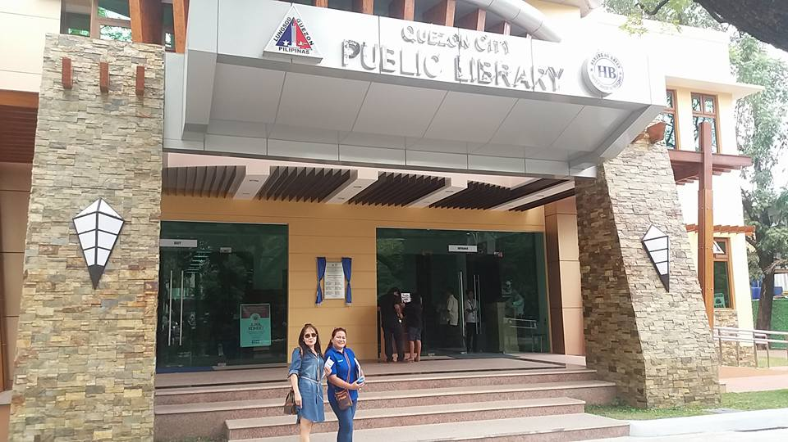
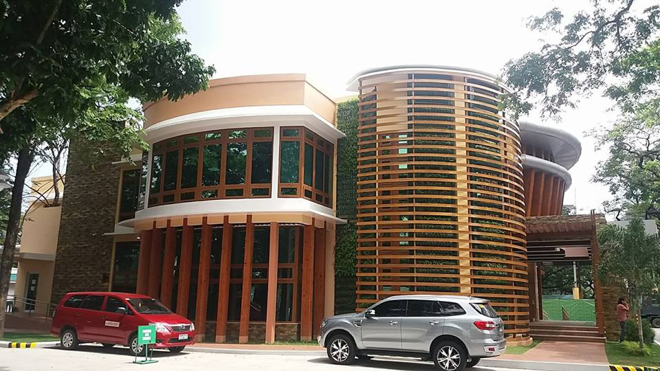
January 30, 2017 at Quezon City Public Library

Slide 6
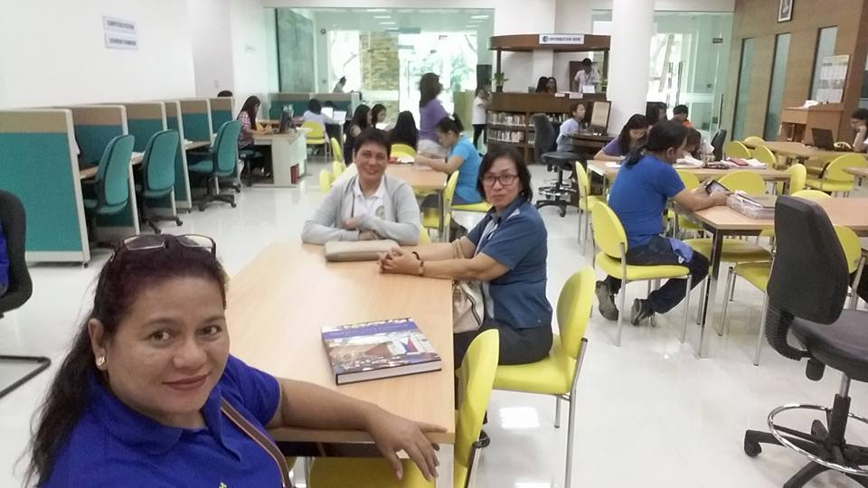

Slide 7
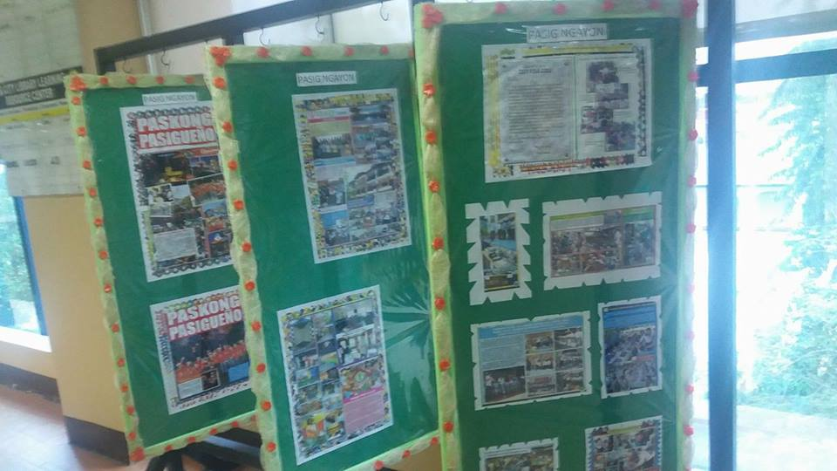
January 30, 2017 at Pasig City Public Library

Slide 8
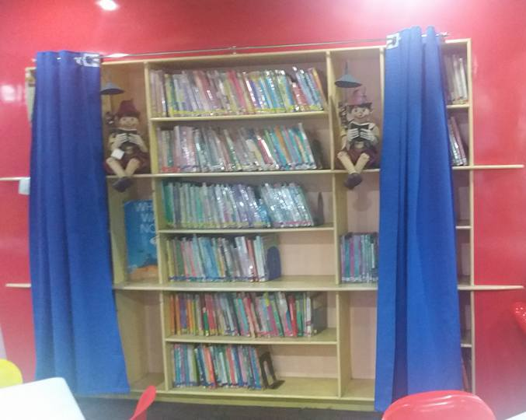

Slide 9
March 10, 2017 at Batangas Public Library

Slide 10
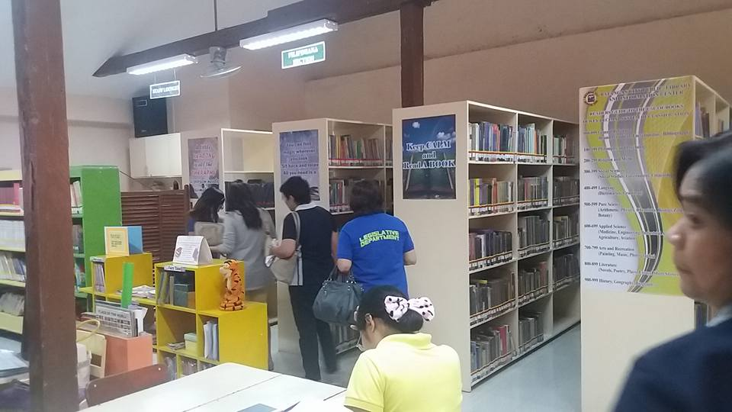

Slide 11
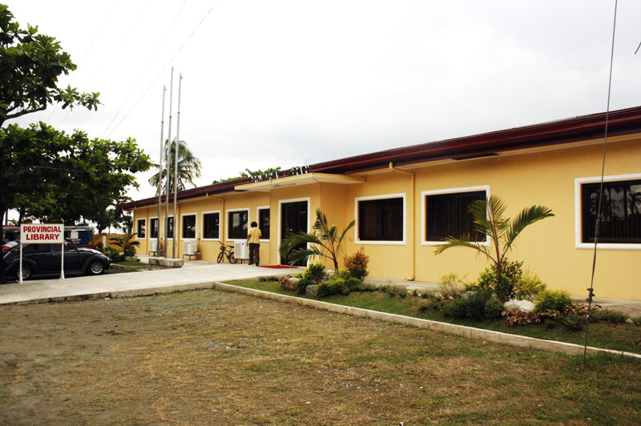
JULY 7, 2017, PANGASINAN PROVINCIAL LIBRARY

Slide 12
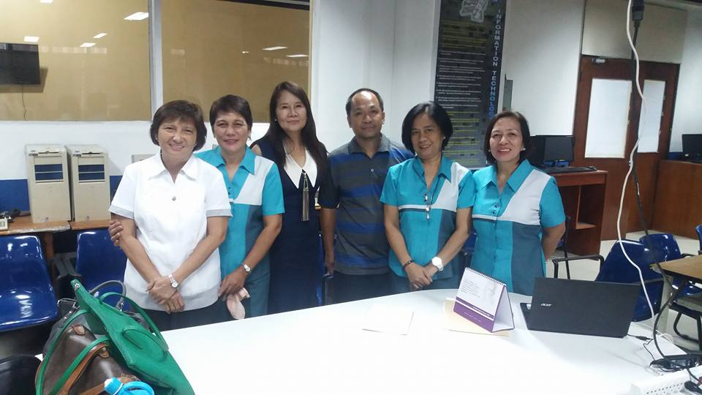
April 10, 2017 Courtesy call to newly appointed NLP Director Mr. Cesar Gilbert Adriano and Asst. Director Edgardo Quiros, who presented to us the latest model of the British framework of modernization of Public Library

Slide 13
BRITISH FRAMEWORK ON MODERNIZATION OF PUBLIC LIBRARIES

Slide 14
COLLABORATION AND COORDINATION

Slide 15
BRAINSTORMING WITH GOVERNOR NINI YNARES

Slide 16
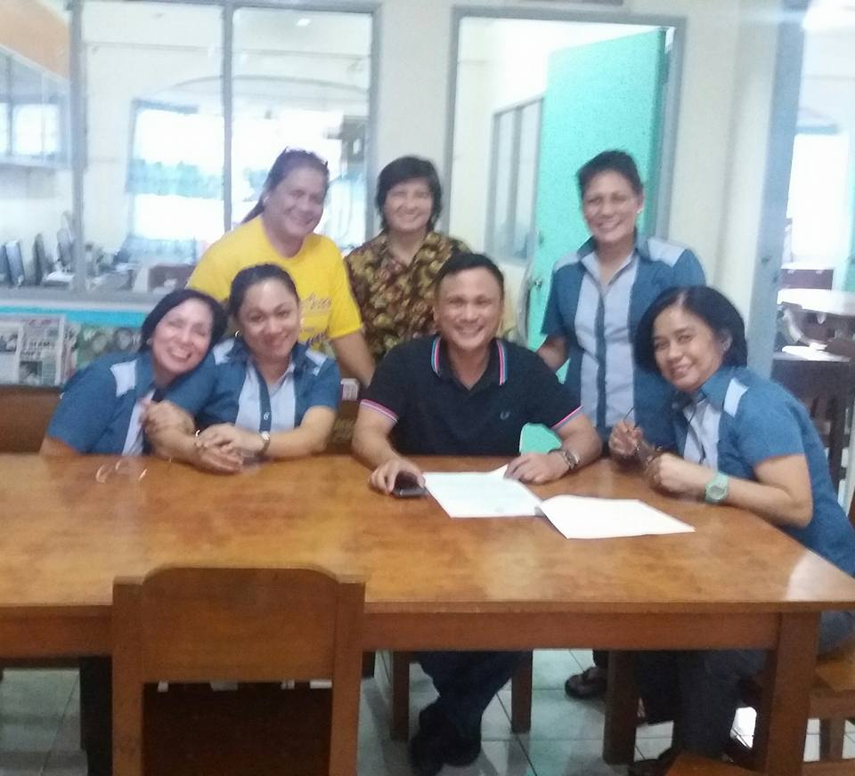
WITH VICE GOVENOR SAN JUAN

Slide 17
WITH ATTY. NARAG, SP BOARD SECRETARY

Slide 18
PLEASES MEMBERS OF RIZAL

Slide 20
AMBISYON 2040

Slide 21
PRES. DUTERTE 10-POINT AGENDA

Slide 22
GOV. NINI YNARES DEV. PROGRAMS

Slide 24
April 19, 2017. Filed a Resolution for the new logo for the Rizal Provincial Library and was approved by the Sangguniang Panlalawigan ng Rizal
A TRANSFORMED LIBRARY

Slide 25
May 25-26, 2018 Conducted a seminar/workshop on Modernization of Public Libraries using the Philippine Framework, Pamilyang Rizaleno.

Slide 26
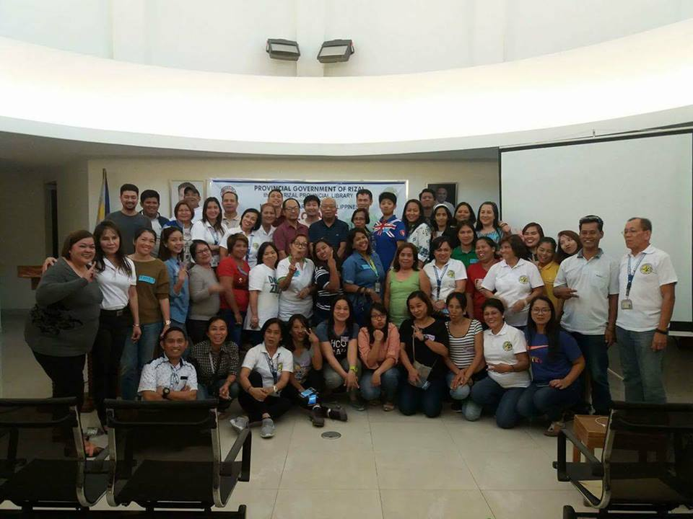

Slide 27
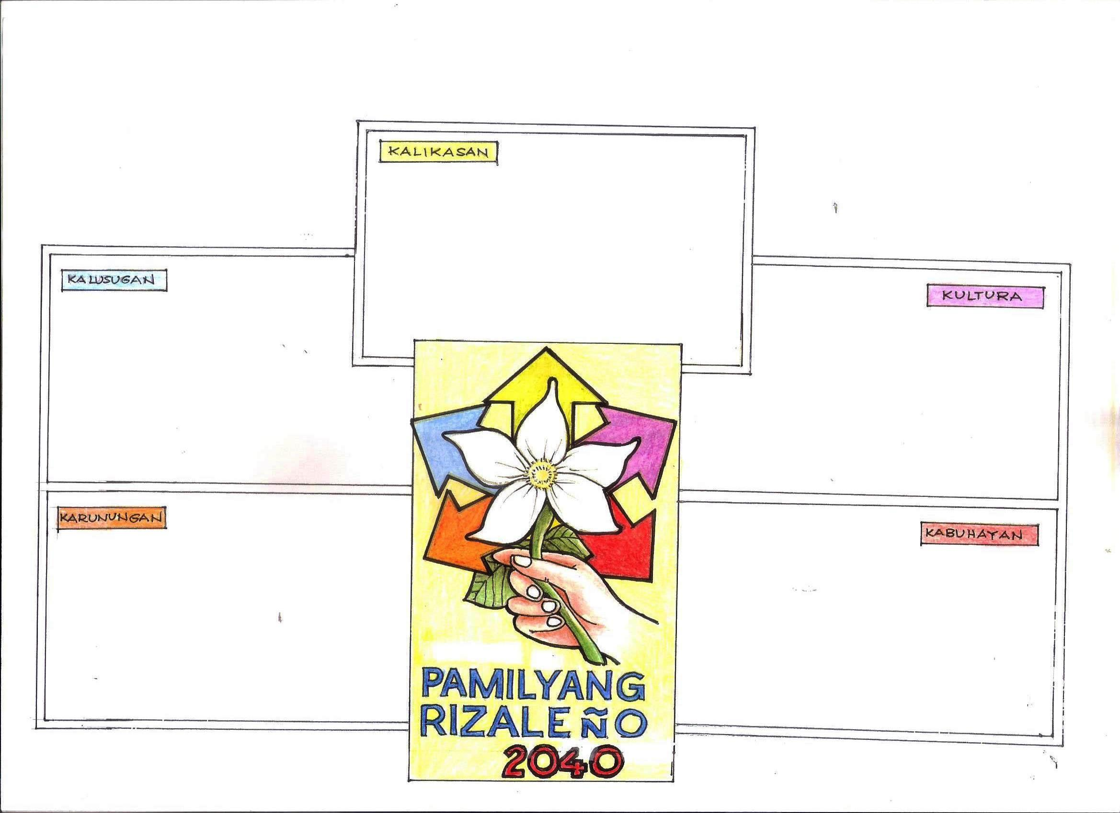
OUTPUT ON SEMINAR ON FRAMEWORK & PROGRAM DEVELOPMENT for PUBLIC LIBRARIES
YES Program of Governor Nini Ynares
Nutrition
Disease & Awareness Prevention
Medical & Health Science Books
Partnership with Voluntary Health Sector
Books as Therapy
Book Festival
Audio Visula Room
Young Readers, Writer & Musician
Film Showing
Cultural Play & Exhibit
Reading to Learn
Support for Dyslexia
Informal Education Program
Computer Literacy for Elders
Mobile Library
Free Wi-Fi
Tech4Ed
Livelihood Seminars

Slide 28
KALIKASAN Tree Planting

Slide 29
KALUSUGAN Storytelling during Medical Mission

Slide 30
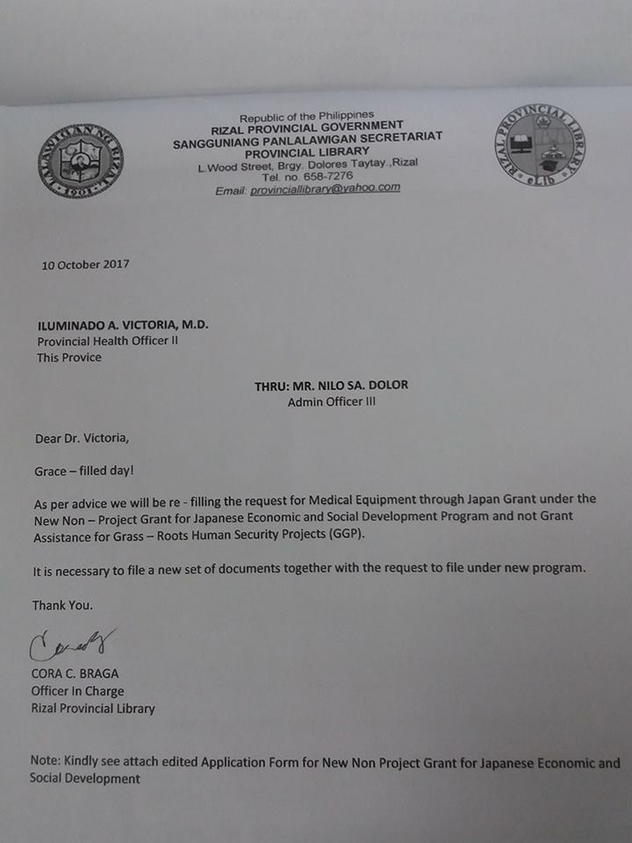
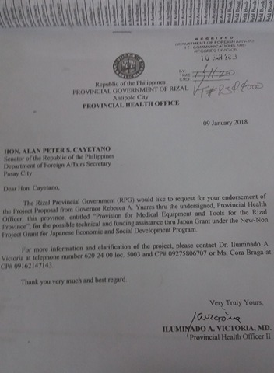
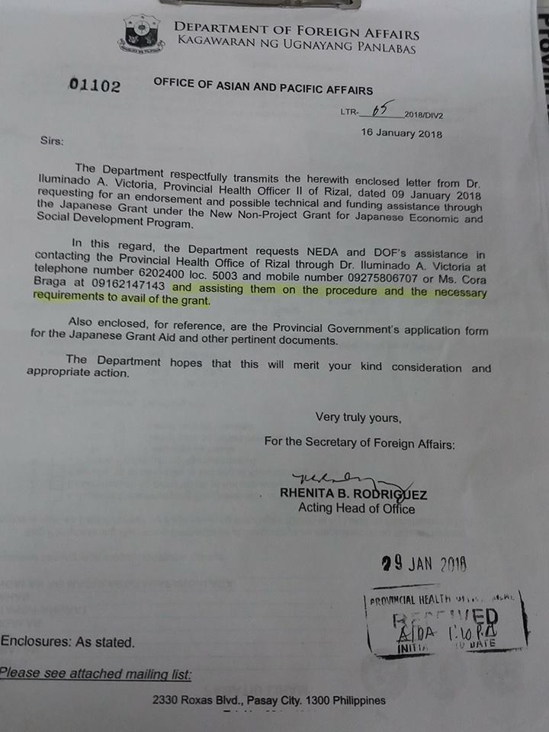
New Non-Project Grant for Japanese Economic & Social Development Program

Slide 31
KULTURA Cultural Heritage Section

Slide 32
KABUHAYAN 51 Talk

Slide 33
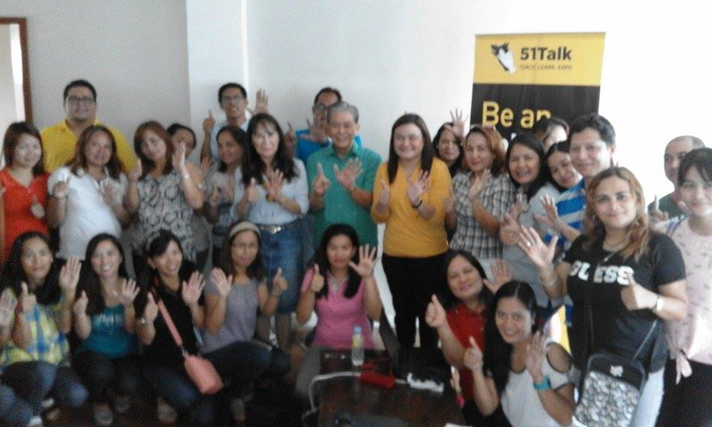
September 21, 2017 at Annex 1 Antipolo, City

Slide 34
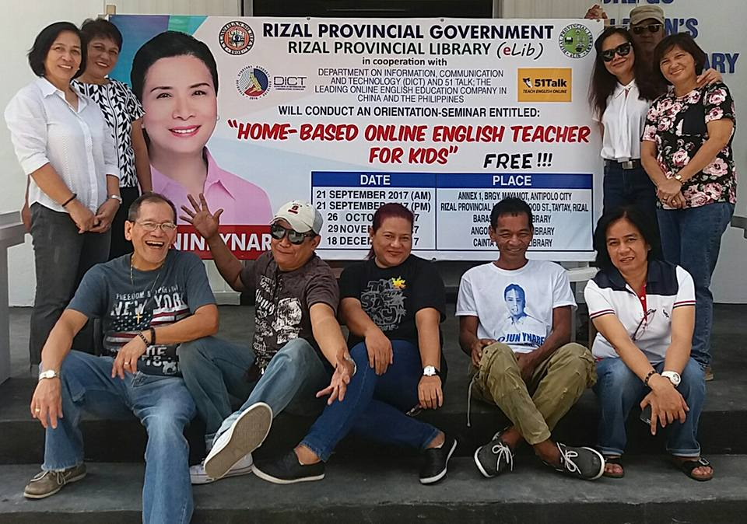
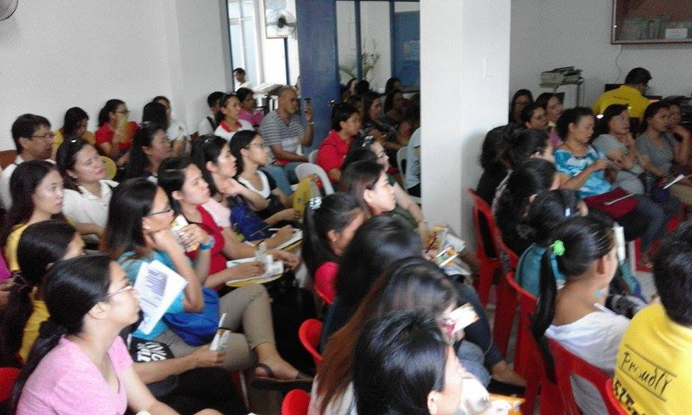
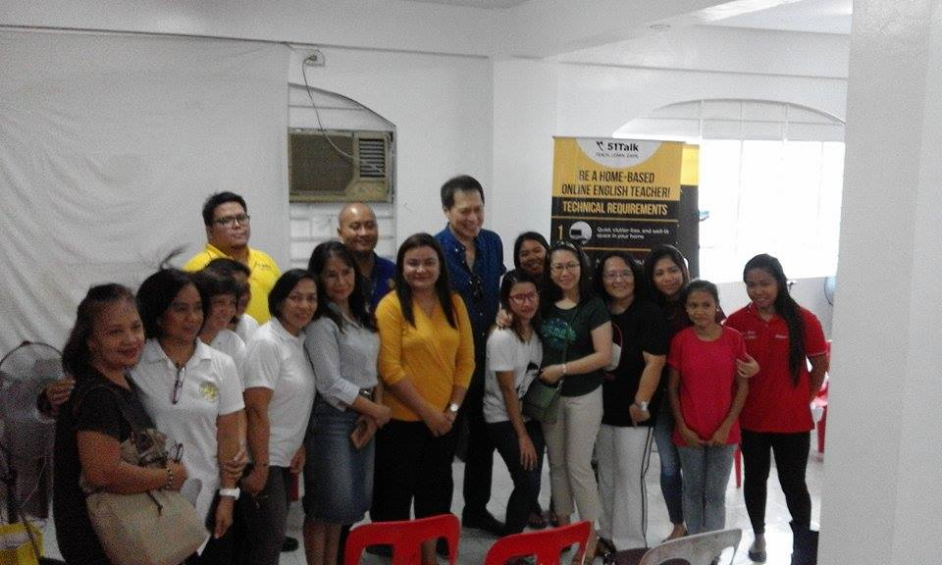
September 21, 2017 at Rizal Provincial Library

Slide 35
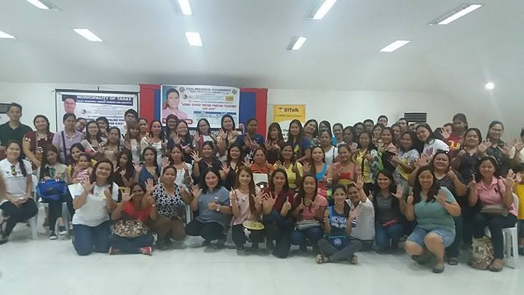
November 19, 2017 at Tanay Municipal Library

Slide 36
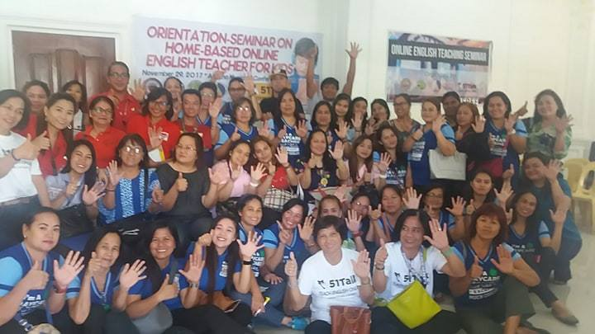
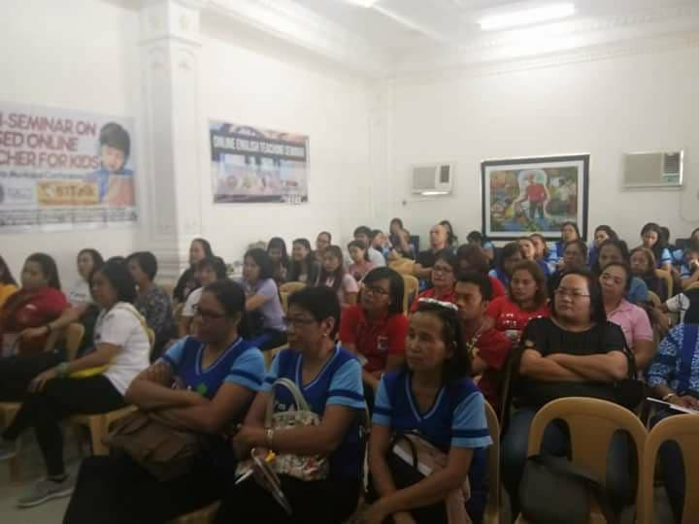
November 27, 2018 at Angono, Rizal

Slide 37
KROPS Orientation for Farmers

Slide 38
July 20, 2017 at Teresa, Rizal

Slide 39
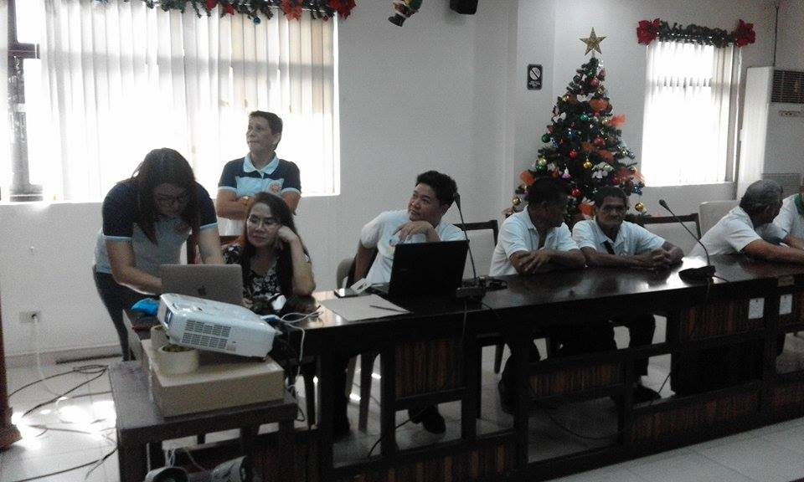
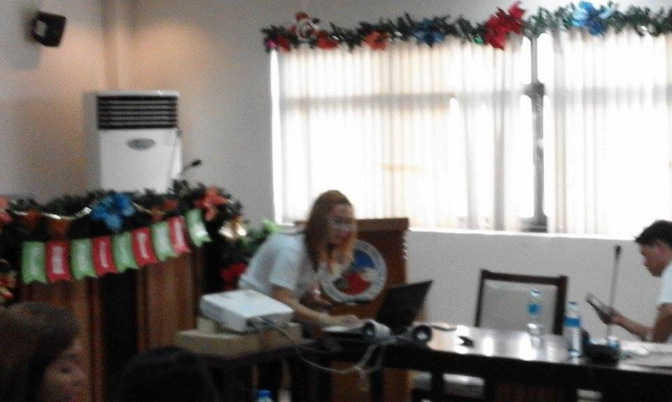
November 23, 2017 at Municipality of Binangonan

Slide 40
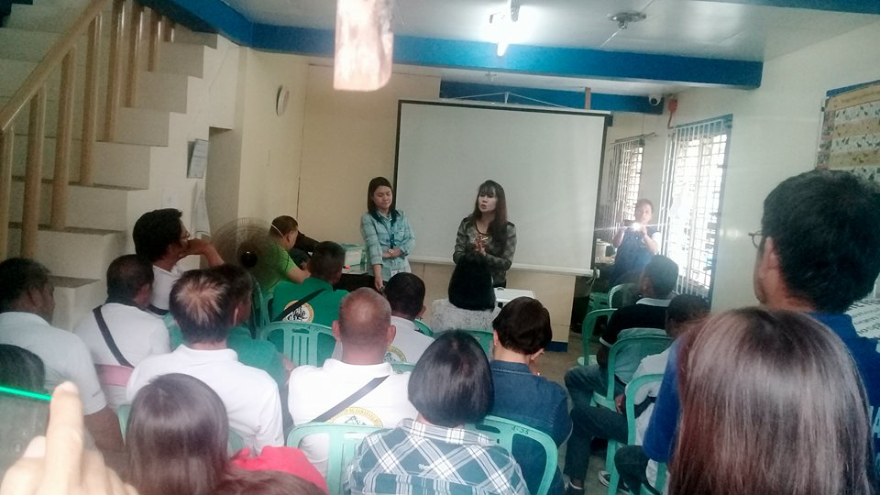
January 25, 2018 at San Mateo, Rizal

Slide 41
KARUNUNGAN Tech4Ed

Slide 42
March 27, 2017 Soft Launching of Tech4Ed at Rizal Provincial Library

Slide 43
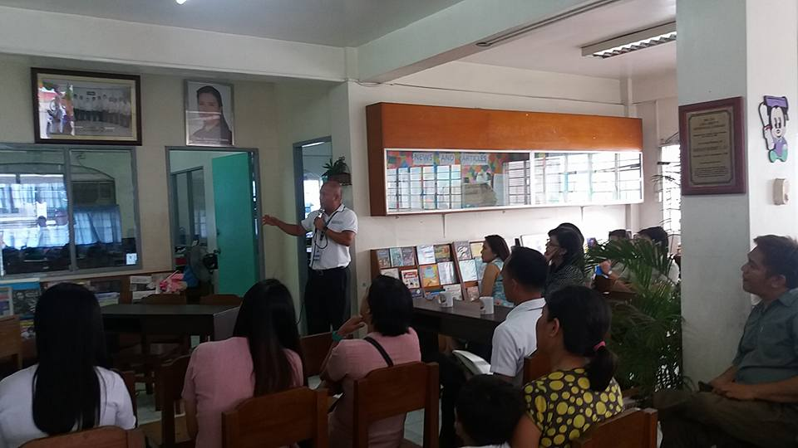

Slide 44
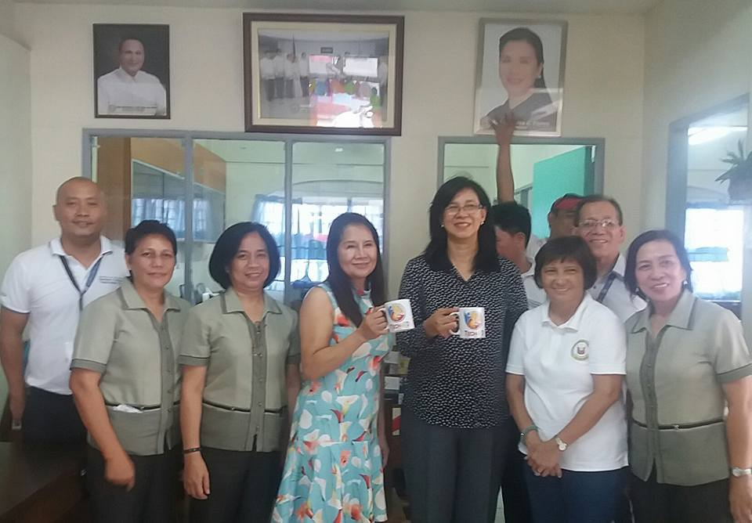

Slide 45
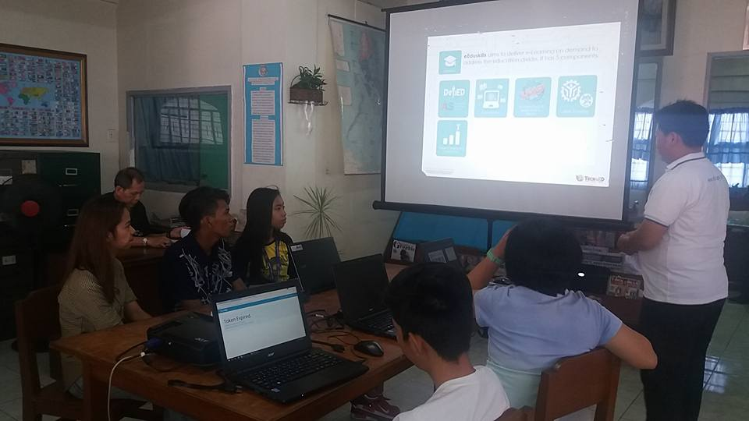
April 7, 2017 Training of Digital Literacy at Rizal Provincial Library conducted by Mr. Wilson Censon and Mr. Mario Aya-ay from DICT

Slide 46
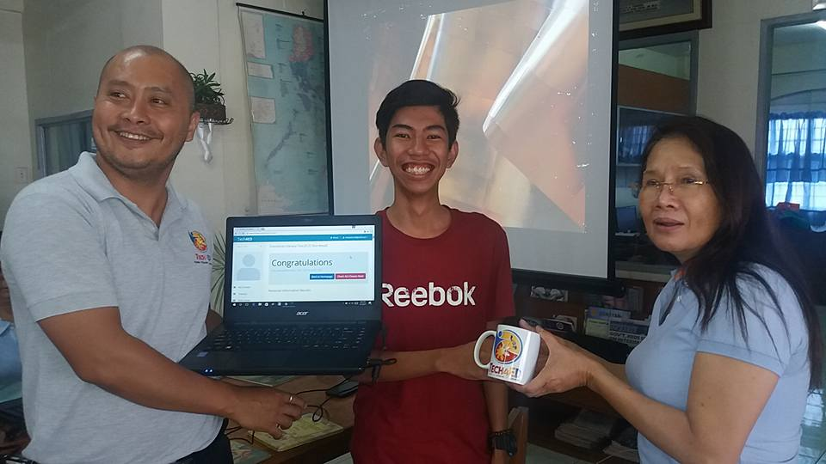

Slide 47
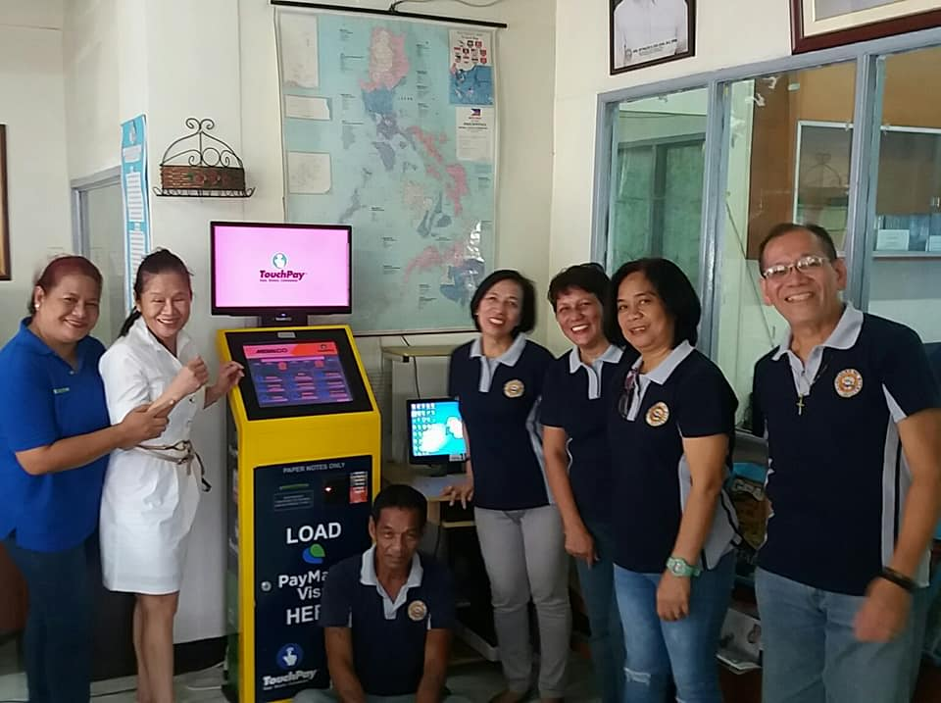
June 22, 2018 on the GO Ynares Electronic Services(YES) Tech4Ed

Slide 48
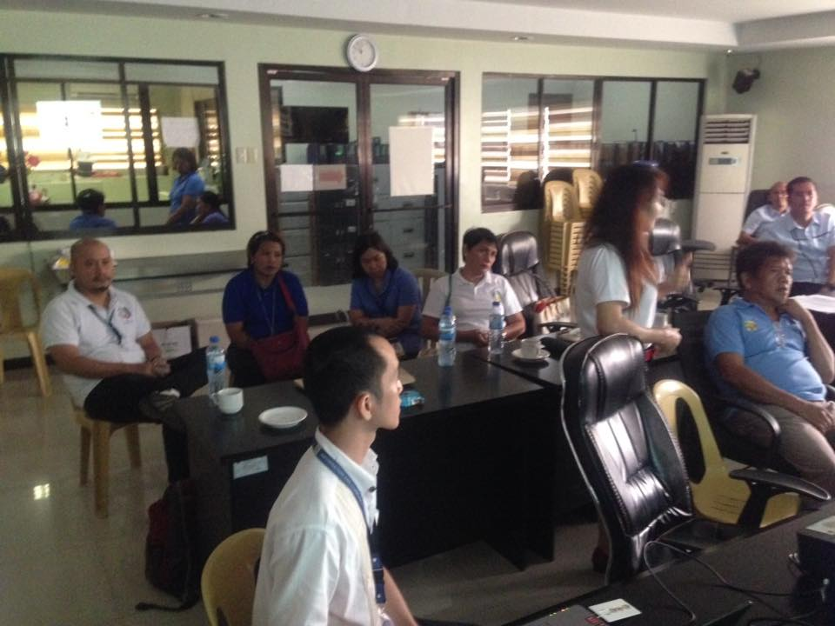
July 12, 2017 at Rodriguez, Rizal

Slide 49
February 1, 2018 at Brgy. Mayamot, Antipolo, City

Slide 51
Tech4Ed Launchings in Rizal Province in coordination with Rizal Provincial Library

Slide 52
June 22, 2018 on the GO Ynares Electronic Services(YES) Tech4Ed

Slide 53
July 12, 2017 at Rodriguez, Rizal

Slide 54
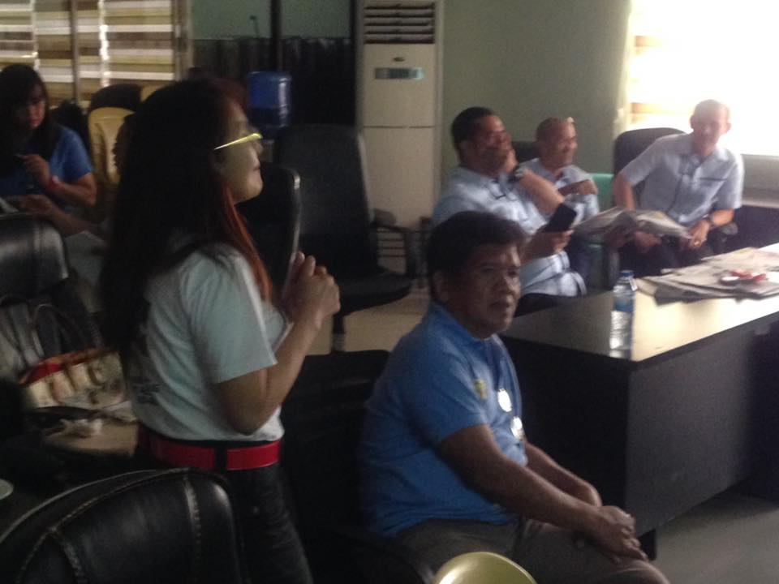

Slide 55
February 1, 2018 at Brgy. Mayamot, Antipolo, City

Slide 56
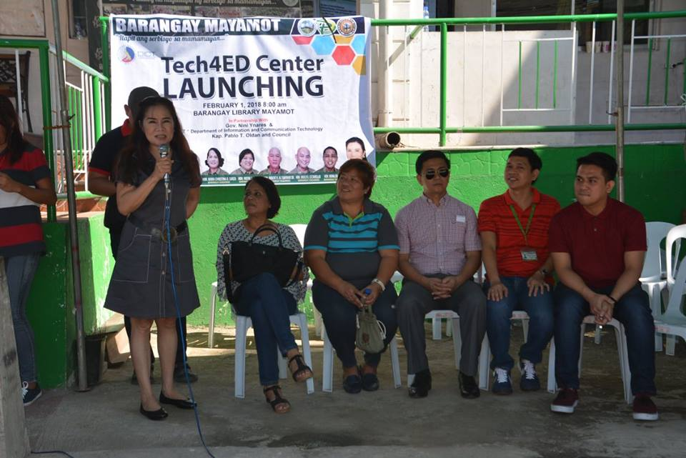
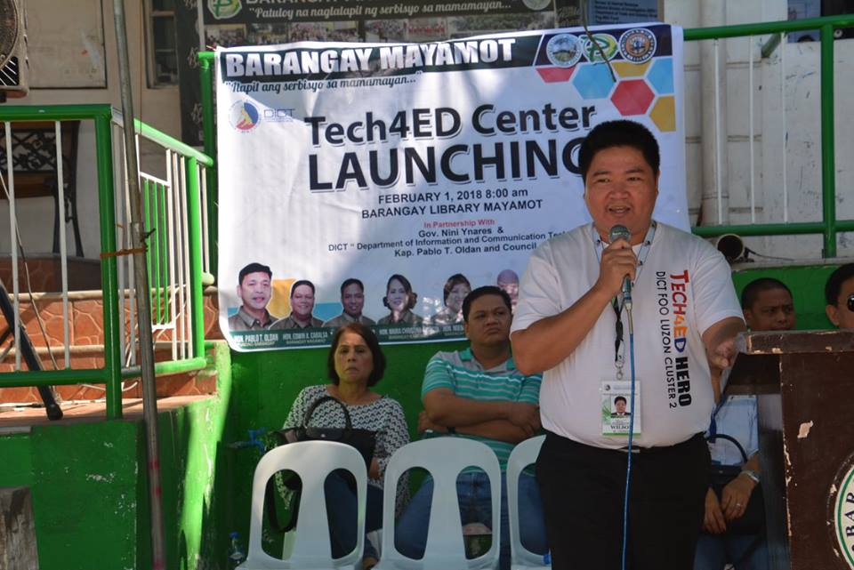

Slide 57
51Talk Orientation/Seminars in coordination with Rizal Provincial Library

Slide 58
September 21, 2017 at Annex 1 Antipolo, City

Slide 59
September 21, 2017 at Rizal Provincial Library

Slide 61
November 19, 2017 at Tanay Municipal Library

Slide 62
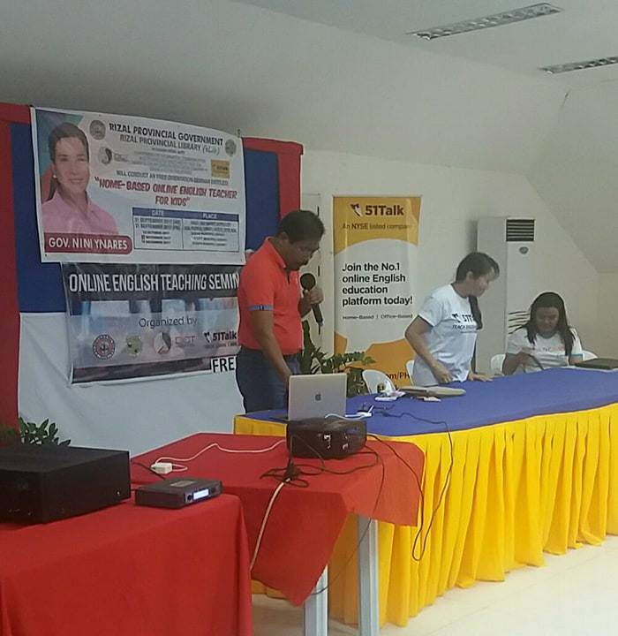

Slide 63
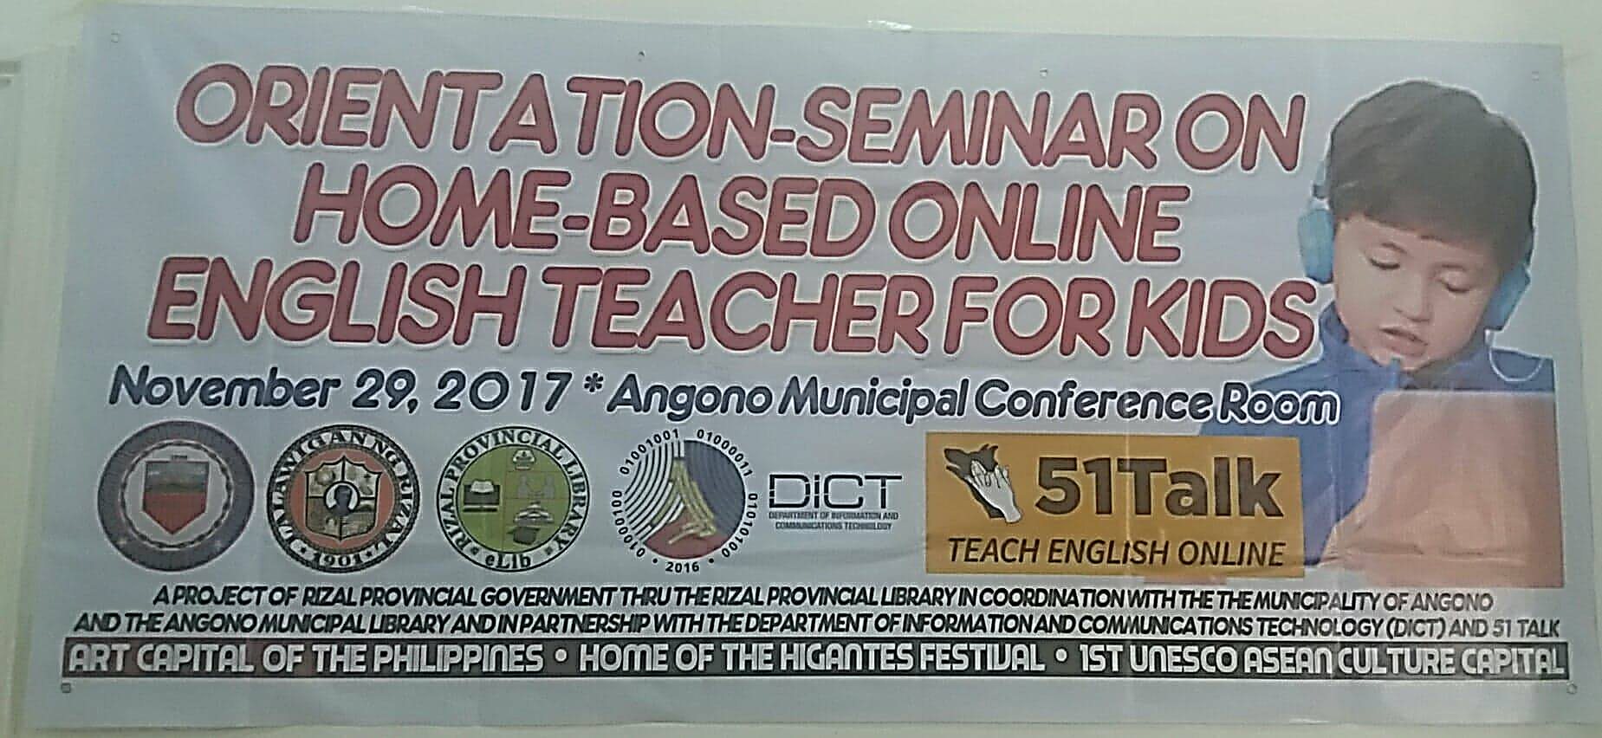
November 27, 2018 at Angono, Rizal

Slide 65
KROPS Orientation for Farmers

Slide 66
July 20, 2017 at Teresa, Rizal

Slide 67
November 23, 2017 at Municipality of Binangonan

Slide 68
January 25, 2018 at San Mateo, Rizal

Slide 69
Intensification of Barangay Reading Center Accreditation

Slide 70
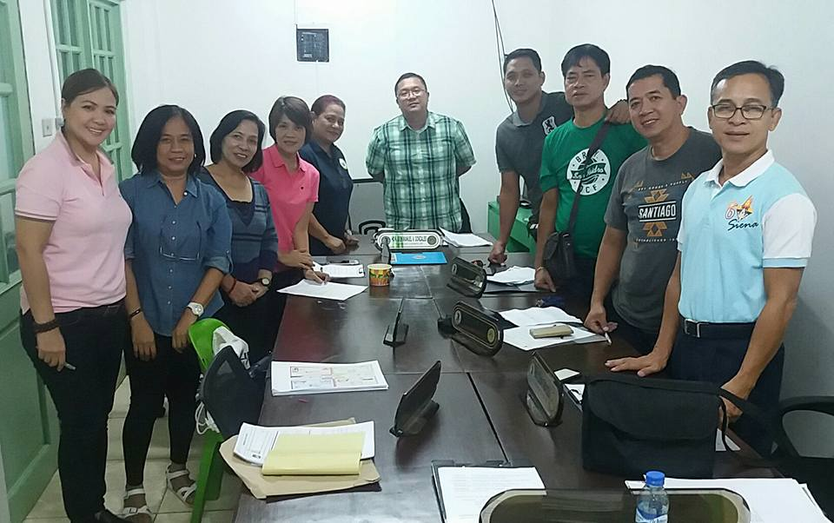
July 21, 2017 at Brgy. San Isidro, Taytay, Rizal

Slide 71
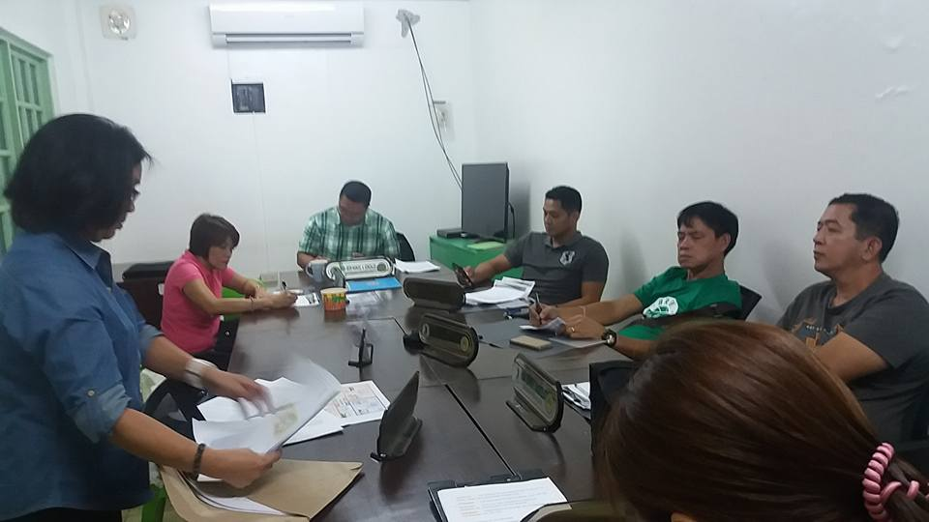
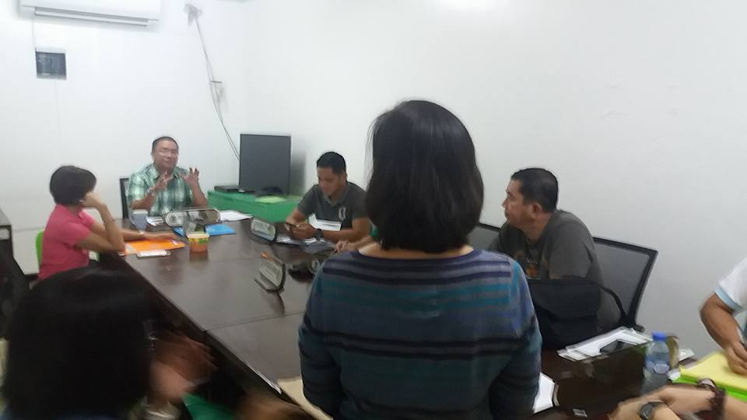

Slide 72
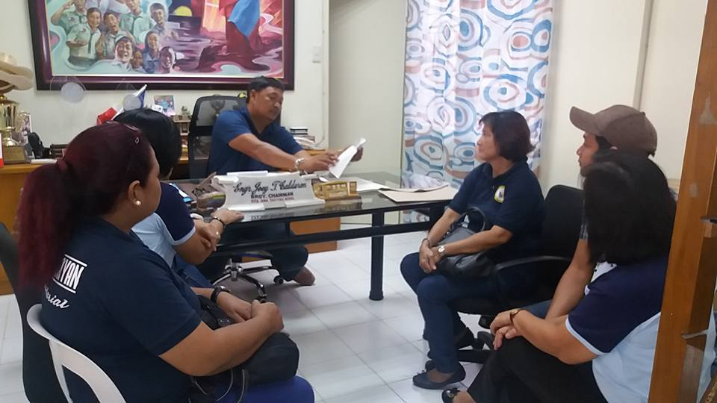
August 11, 2017 at Brgy. Sta. Ana, Taytay, Rizal

Slide 73
2nd Place Poster Making Contest with the theme of Limang K para maging OK sa Aklatan for the National Conference of Librarians 2018

Slide 74
RESOLUTION ADOPTING 09 MARCH OF EVERY YEAR AS PUBLIC LIBRARY DAY PURSUANT TO PROC. NO. 563, S. 1959

Slide 75
TRIPLE CELEBRATION OF PUBLIC LIBRARY DAY, MARCH 9, 2018

Slide 76
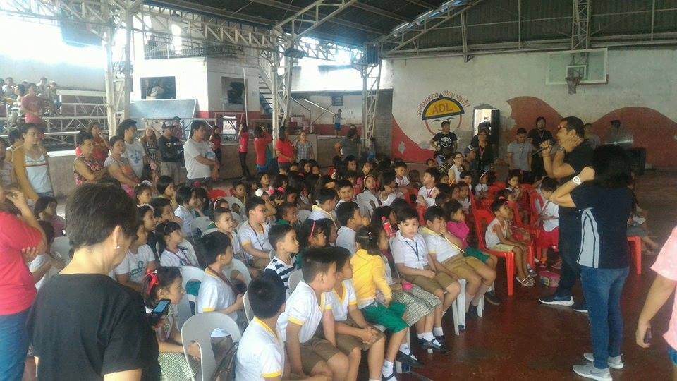
IT’S STORY TIME at BRGY. DOLORES W/ MAM JOAN GACULA and KAP ALLAN DE LEON as GUEST STORYTELLERS

Slide 77
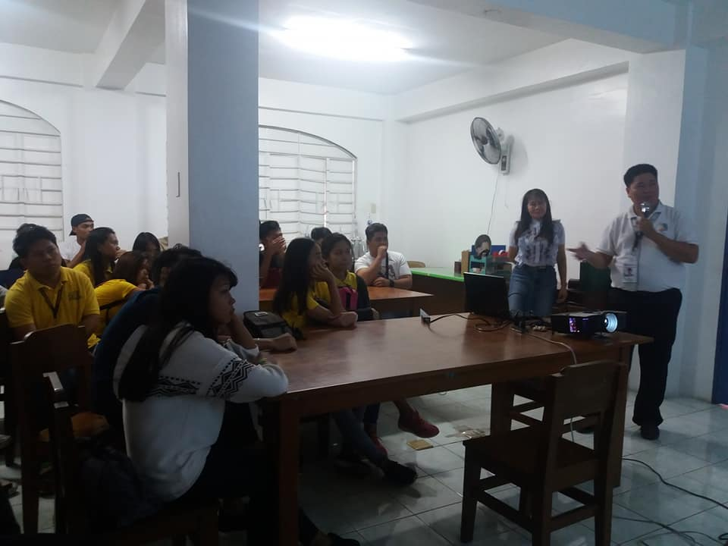
FREE and FUN TECHNOLOGY SEMINAR CONDUCTED BY DICT W/ VICE MAYOR BONOY GONZAGA AS GUEST

Slide 78
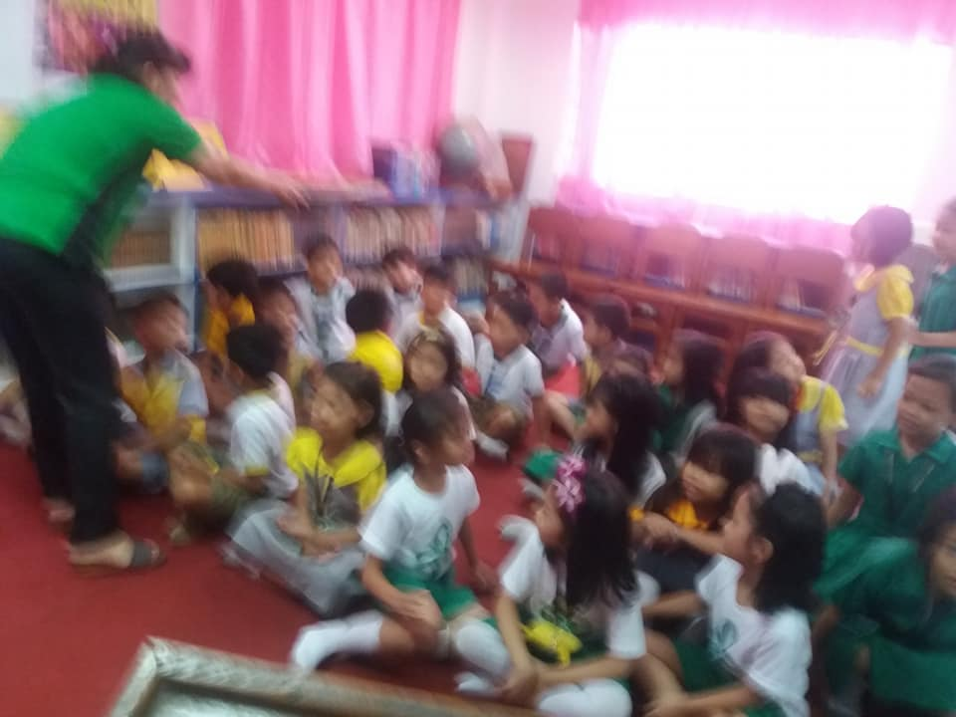
MARIKINA VALLEY LIONS CLUB SHARED FOODS, TOYS AND STORIES W/ CHILDREN

Slide 79
TO KNOW MORE ABOUT 5K, PLEASE VISIT OUR WEBSITE @ provinciallibrary.rizalprovince.ph
THANK YOU!

